Slide 1
ML – Models – Linear Regression
Mukund - JnanaAdvisory

Slide 2
ML Model Continued ..
Machine learning models can be classified in many ways to suit a purpose
Supervised vs Unsupervised.
Parametric Vs. Non parametric
Classify by purpose ( Calssification vs regression)
Classify by Data
Linear or Non Linear
Let us look at some examples……

Slide 3
Supervised vs unsupervised learning
Supervised Learning
Unsupervised Learning

Slide 4
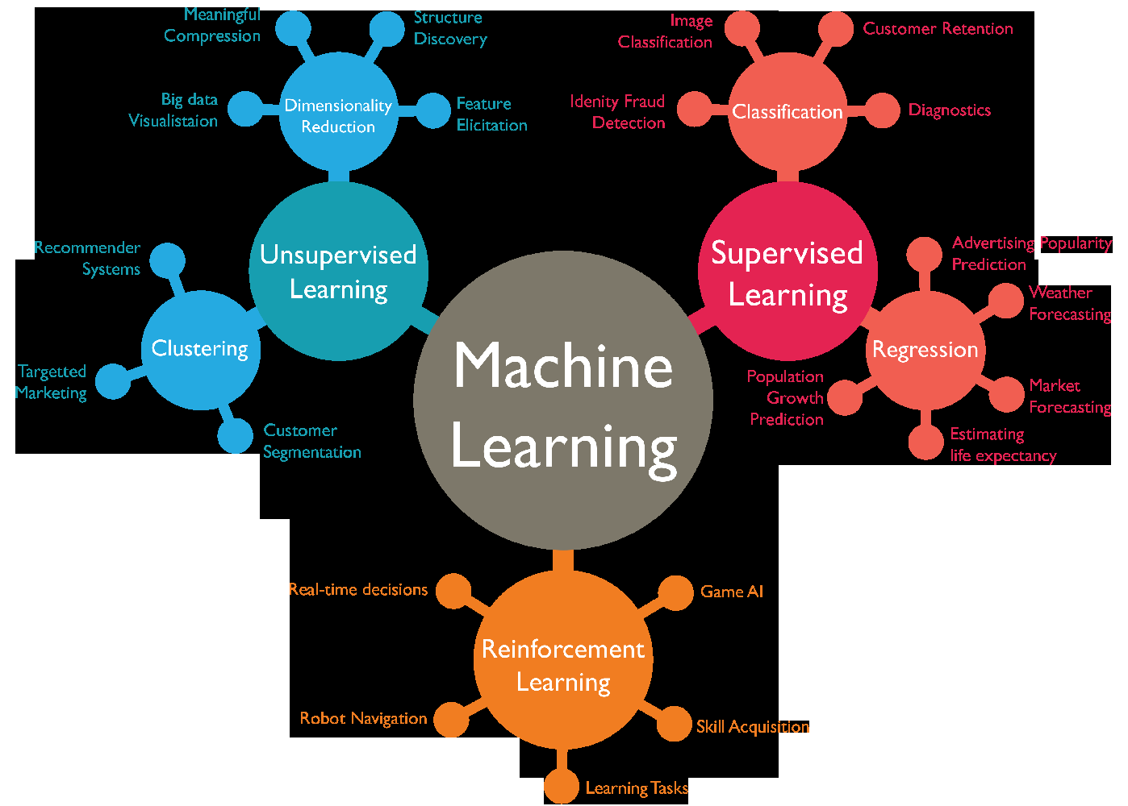
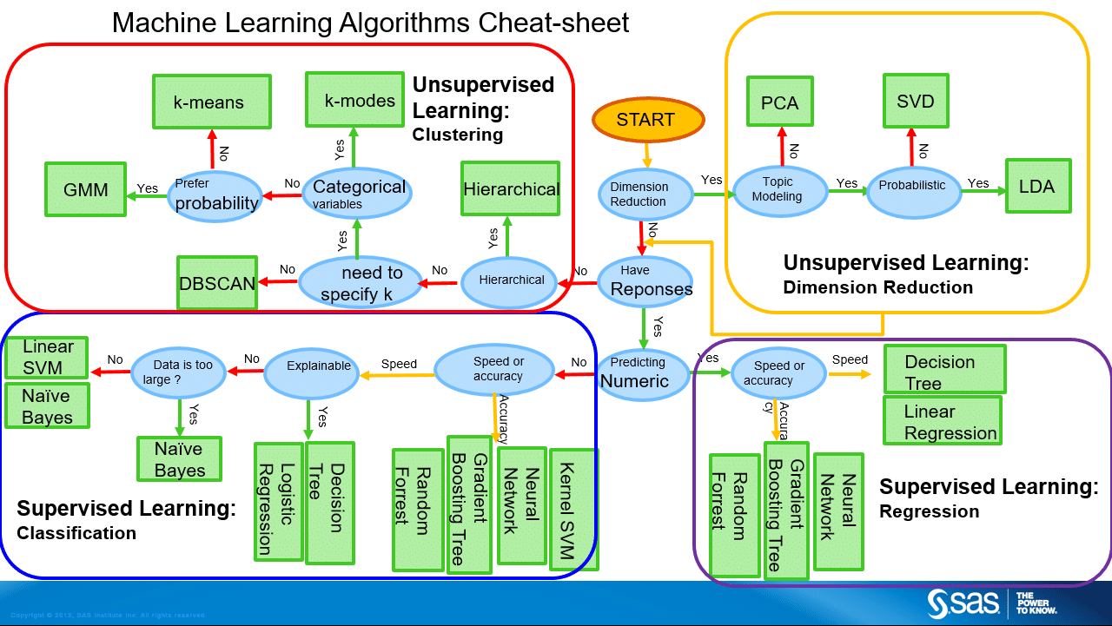
Some common Algos/model by supervised/unsupervised
We will learn More in subsequent Slides

Slide 5
Paramateric vs Non PARAMETRIC
Parametric
Definition
A learning model that summarizes data with a set of parameters of fixed size (independent of the number of training examples) is called a parametric model. No matter how much data you throw at a parametric model, it won’t change its mind about how many parameters it needs.
Assumption - that data is of the form (OR SOME HIGHER ORDER)
b0 + b1*x1 + b2*x2 = 0
Reality - Underlying Data does not conform to a linear model
Benefits
Simpler: These methods are easier to understand and interpret results.
Speed: Parametric models are very fast to learn from data.
Less Data: They do not require as much training data and can work well even if the fit to the data is not perfect.
Limitations
Constrained: By choosing a functional form these methods are highly constrained to the specified form.
Limited Complexity: The methods are more suited to simpler problems.
Poor Fit: In practice the methods are unlikely to match the underlying mapping function.
Some Examples
Logistic Regression
Linear Discriminant Analysis
Perceptron
Naive Bayes
Simple Neural Networks
Non parametric
Definition
Nonparametric methods are good when you have a lot of data and no prior knowledge, and when you don’t want to worry too much about choosing just the right features.
Nonparametric methods seek to best fit the training data in constructing the mapping function, whilst maintaining some ability to generalize to unseen data. As such, they are able to fit a large number of functional forms.
Benefits
Flexibility: Capable of fitting a large number of functional forms.
Power: No assumptions (or weak assumptions) about the underlying function.
Performance: Can result in higher performance models for prediction.
Limitations
More data: Require a lot more training data to estimate the mapping function.
Slower: A lot slower to train as they often have far more parameters to train.
Overfitting: More of a risk to overfit the training data and it is harder to explain why specific predictions are made.
Some Examples
k-Nearest Neighbors
Decision Trees like CART and C4.5
Support Vector Machines
In statistics, a fit refers to how well you approximate a target function. Over fitting refers to a model that models the training data too well.. Under fitting refers to a model that can neither model the training data nor generalize to new data.

Slide 6
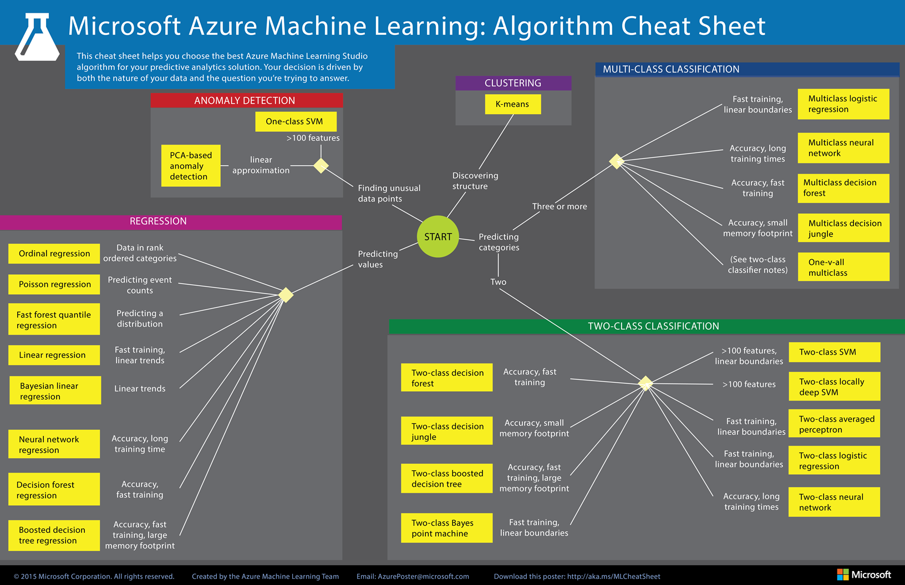
Classification ML – BY Purpose

Slide 7
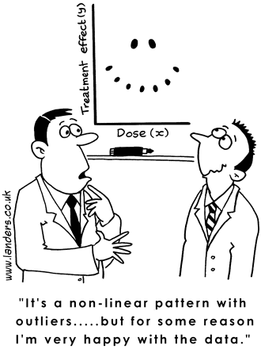

Slide 8
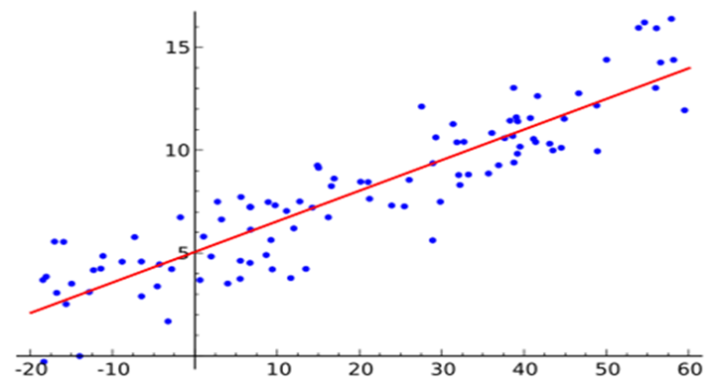
Linear Regression
Linear regression assumes a linear or straight line relationship between the input variables (X) and the single output variable (y).
More specifically, that output (y) can be calculated from a linear combination of the input variables (X). When there is a single input variable, the method is referred to as a simple linear regression.
Once the coefficients are known, we can use this equation to estimate output values for y given new input examples of x.
1 | y = b0 + b1 * x

Slide 9
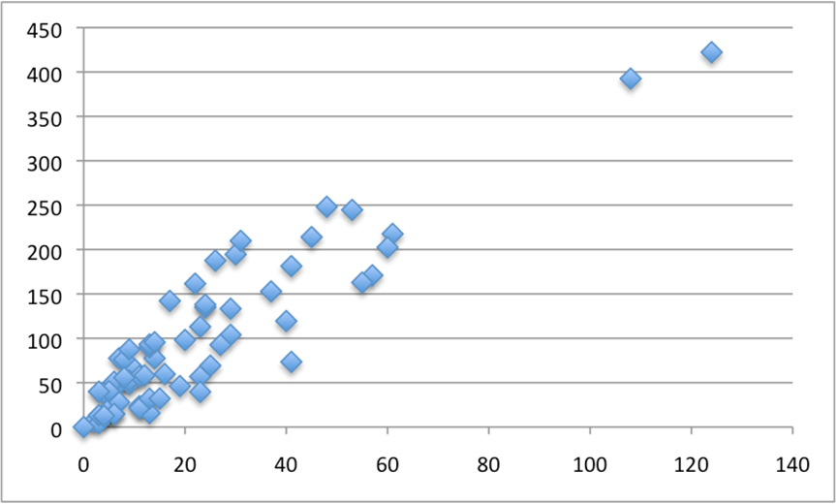
Linear Regression using Auto Insurance data
The dataset is called the “Auto Insurance in Sweden” dataset and involves predicting the total payment for all the claims in thousands of Swedish Kronor (y) given the total number of claims (x).
This means that for a new number of claims (x) we will be able to predict the total payment of claims (y).
A scatter plot of Insurance data

Slide 10
Steps in Linear Regression
Calculate Mean and Variance.
Calculate Covariance.
Estimate Coefficients.
Make Predictions.
Predict Insurance.

Slide 11
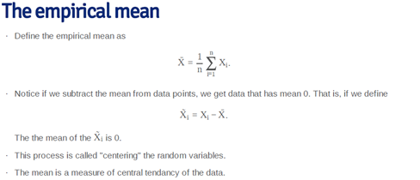
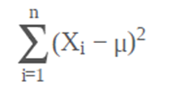
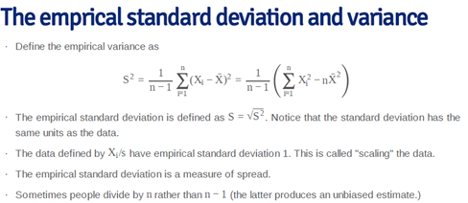
What is Mean
Mean is also the least square solution for minimizing

Slide 12
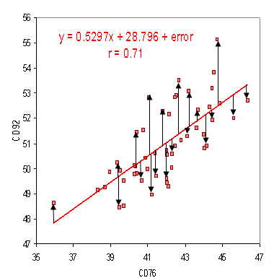

RMSE – a measure of fit of regression
Ordinary Least Squares
When we have more than one input we can use Ordinary Least Squares to estimate the values of the coefficients.
The Ordinary Least Squares procedure seeks to minimize the sum of the squared residuals. This means that given a regression line through the data we calculate the distance from each data point to the regression line, square it, and sum all of the squared errors together. This is the quantity that ordinary least squares seeks to minimize.

Slide 13
Actual code here.
http://localhost:8888/notebooks/Swedish%20house%20prediction%20-%20linear%20regression.ipynb

